Slide 1
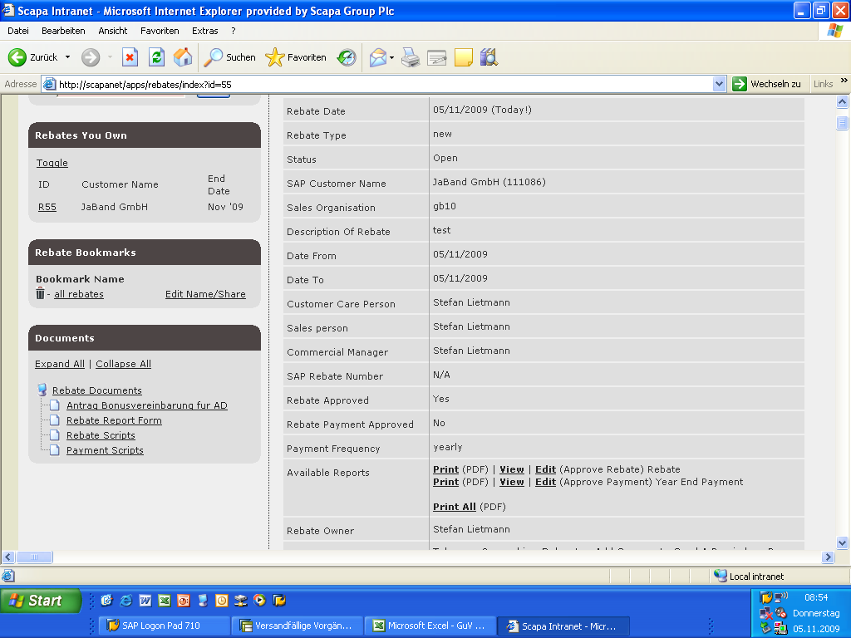
1. click edit approve payment

Slide 2
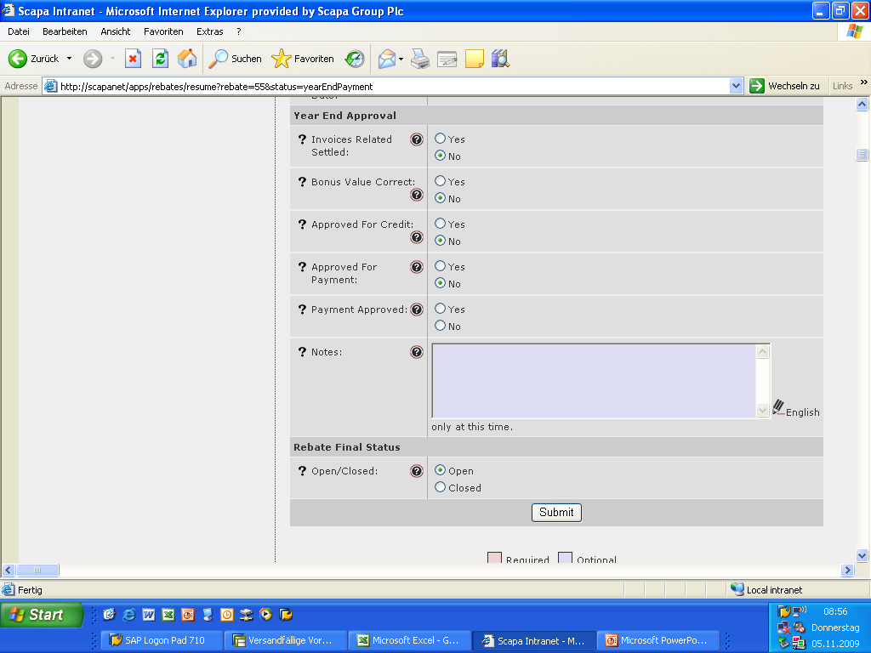
check all the parameters here
these fields indicate if you decide to credit or pay
then click on payment approved and submit

